Slide 1
Introduction To Hypervisors – Type 1 Hypervisors – Type 2 Hypervisors – Comparing Hypervisors – Virtualization Considerations For Cloud Providers.
CSE4011-
MODULE 2
Hypervisors
VIRTUALIZATION Dr.S.ANTO

Slide 2
Introduction To Hypervisors
Hypervisor –other name -Virtual Machine Monitor (VMM)
It can be a piece of software, firmware or hardware that gives an impression to the guest machines (VM) i.e., virtual machines as if they were performing on a physical hardware.
It allows some of the multiple operating systems to share a single host and its hardware.
Hypervisor manages requests by the virtual machines to access the hardware resources like RAM, CPU, and NIC etc.
This acts as an independent machine.

Slide 3
Hypervisors- Types
The hypervisor is mainly divided into two types they are:
1) Type-1/Native/Bare Metal Hypervisor. 2) Type-2/Hosted Hypervisor.

Slide 4
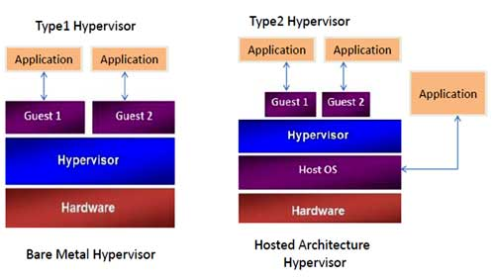
Hypervisors- Types

Slide 5
Type-1 Hypervisor
Also known as Bare Metal or Embedded or Native Hypervisor.
Type-1 hypervisor runs directly on the hardware with the Virtual Machine resources provided by the hypervisor.
Works directly on to the hardware of the host and that can monitor the operating systems can run on above hypervisor.
It is completely individualistic from the Operating System.
Type-1 Hypervisor is small and its main role is sharing and managing the hardware resources between different operating systems.

Slide 6
Type-1 Hypervisor- Advantage
Any problem in one virtual machine or a guest operating system that do not affect the other guest operating systems which are running on the hypervisor.

Slide 7
Type-1 Hypervisor- Examples
VMware ESXi Server
Microsoft Hyper-V
Citrix/Xen Server

Slide 8
Type-2 Hypervisor
Also known as Hosted Hypervisor.
Runs on a host operating system that provides a virtualization service.
Type-2 Hypervisor is installed on an operating system and then it supports in other operating systems.
Completely dependent on a host Operating Systems for its operations.
While having a base operating system that allows better specifications of policies, In this case, any problems in the base operating system it affects the entire system as well if the hypervisor is running on above of base OS is secure.

Slide 9
Type-2 Hypervisor- Examples
VMware Workstation.
Microsoft Virtual PC.
Oracle Virtual Box.

Slide 10
Type 1 vs. Type 2 Hypervisors
Type 1 hypervisor- it enables the hardware virtualization
Type 1 hypervisor -better performance and greater flexibility because it operates as a thin layer designed to expose hardware resources to virtual machines (VMs), reducing the overhead required to run the hypervisor itself.
Servers that run Type 1 hypervisors are often single-purpose servers that offer no other function.
They become part of the resource pool and are designed specifically to support the operation of multiple applications within various VMs.

Slide 11
Type 1 vs. Type 2 Hypervisors
Type 1 hypervisor- more efficient than a Type 2 hypervisor, yet in many ways they both provide the same type of functionality because they both run the same kind of VMs.
Possible to move a VM from a host server running a Type 1 hypervisor to one running a Type 2 hypervisor and vice versa.
A conversion may be required, but the process works.
Type 2 hypervisor- run as an application on top of an operating system; perform software virtualization.
Type-1 and Type-2 hypervisors came up with an arbitrary distinction that does not require an inherent understanding of the requirements of virtualization.

Slide 12
Virtualization Hypervisor Usage
Type 1 hypervisors are VM monitors that are designed to keep track of all of the events that occur within a VM and, when required, provide or deny access to appropriate resources to meet VM operating requirements.
Ideally, the VM monitor will perform its operations through the use of policies that contain all of the settings assigned to a particular VM.
Consider a hardware virtualization hypervisor when you need to perform any of the following:
System consolidation | Application high availability
System testing | Resource optimization
Heterogeneous system operation | Service flexibility
Hardware optimization | Dynamic resource management

Slide 13
Virtualization Hypervisor Usage
System consolidation: Support the operation of multiple systems on the same physical hardware, reducing costs and the physical server footprint while delivering similar and often improved services.
System testing: Hypervisors support the isolation of systems, letting you test new software and applications without affecting production. They also provide a low-cost testing alternative to physical systems.
Heterogeneous system operation: Support the simultaneous execution of multiple operating systems on the same physical hardware, letting organizations run heterogeneous systems on reduced hardware footprints.
.

Slide 14
Virtualization Hypervisor Usage
Hardware optimization: Hypervisors increase hardware usage through the operation of multiple workloads on each physical host server. Server usage can increase from 5% to 10% to upwards of 60% or 70%.
Application high availability: By sharing workloads through technologies such as failover clustering, servers running virtualization hypervisors can support application high availability and ensure that services are always available when running inside VMs.
Resource optimization: By running different applications in separate VMs, hypervisors can increase resource use because each application requires a number of resources at different times.

Slide 15
Virtualization Hypervisor Usage
Service flexibility: Because hypervisors support the operation of systems through VMs, organizations gain flexibility because VMs are easier to clone and reproduce than physical machines.
Dynamic resource management: Virtualization hypervisors support manual or automated resource allocation to VM workloads as peak usage occurs. Because of this, hypervisors provide better support for dynamic resource allocation in data centers.

Slide 16
Importance of Virtualization in Cloud Computing
Cloud can exist without Virtualization, although it will be difficult and inefficient.
Cloud makes notion of “Pay for what you use”, “infinite availability- use as much you want”.
These notions are practical only if we have
lot of flexibility
efficiency in the back-end.
This efficiency is readily available in Virtualized Environments and Machines

Slide 17
Requirement for Virtualizability
Popek and Goldberg mentioned a set of requirements that must be met for virtualization
They divided instructions into three categories:
Privileged instructions: execute in a privileged mode, but will trap otherwise.
Control sensitive instructions: attempt to change the config of resources
Behavior sensitive instructions: are those that behave in a different way depending on the config of resources

Slide 18
Requirement for Virtualizability
They said that all sensitive instructions must also be privileged instructions.
Hypervisor must be able to intercept any instructions that changes the state of the machine in a way that impacts other processes.

Slide 19
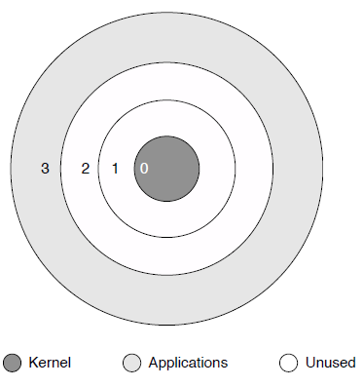
Privilege Rings
Memory page has a 2 bit code which is checked by CPU before executing the instruction.
If privilege level is insufficient the CPU does not executes the instruction.
0 – Highest Privilege

Slide 20
VM Implementation Techniques
1.Binary Translation
2.Paravirtualization
3.Hardware Supported Virtualization

Slide 21
1. Binary Translation
Used in VMWare
Binary image of OS is manipulated at the runtime.
Privileged instructions are rewritten to point to their emulated versions.
Performance from this approach is not ideal, particularly when doing anything I/O intensive.
Caching of the locations of unsafe instructions can speed Up

Slide 22
2. Para virtualization
Used in XEN
Make OS aware of underlying Virtualization env.
OS's code is manipulated.
Important system calls are changed to point to the implementation provided by the VMM.

Slide 23
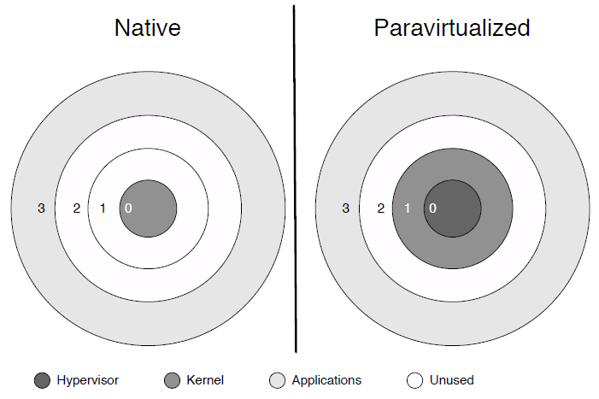
Para virtualization

Slide 24
3. HW Supported Virtualization
Added new instructions which makes Virtualization considerably easier for x86.
Intel – IVT(Intel Virtualization Technology)
AMD – introduced AMD-V
OS stays in its original privilege level 0.
Attempts to access the hardware directly are caught and passed to VMM.
In other words a new privilege ring is setup for the VMM.

Slide 25
HW Supported Virtualization
“1” ring of VMM

Slide 26
Conclusion
Notion of Cloud is possible without Virtualization, but it will be inefficient and inflexible.
Virtualization is an attempt to manage OS.
There are many levels and many ways to implement Virtualization.

